Slide 1
Coursera Capstone Project
Opening and Italian Restaurant in Sheffield

Slide 2
Introduction
An Italian Chef has moved to Sheffield and is wanting to open a restaurant
I will try to find an optimal location for a Italian restaurant in Sheffield
Since there are lots of restaurants in Sheffield I will try to detect locations that are not already crowded with restaurants
My client is particularly interested in areas with no Italian restaurants in vicinity
She would also prefer locations as close to city centre as possible
I will generate a list of few most promising neighbourhoods based on these criteria

Slide 3
Data – Part 1
To analyse the problem I will use:
number of existing restaurants in the neighbourhood (any type of restaurant)
number of and distance to Italian restaurants in the neighbourhood
distance of neighbourhood from city centre
I will use regularly spaced grid of locations, centred around city center, to define the neighbourhoods

Slide 4
Data – Part 2
Data sources:
centres of candidate areas will be generated algorithmically and approximate addresses of centres of those areas will be obtained using Google Maps API reverse geocoding
number of restaurants and their type and location in every neighbourhood will be obtained using Foursquare API
coordinate of Sheffield centres will be obtained using Google Maps API geocoding of well known Sheffield location (Peace Gardens)

Slide 5
Methodology - 1
The city was partitioned into a grid of uniform size
The presence of restaurants in this grid was calculated
The grid was mapped so that it could be seen geographically
The presence was also calculated using a heat map
Areas of known student populations were preferred
Farmland was avoided
A list of the most likely candidate areas was then compiled
A reverse-lookup turned this into a list of addresses

Slide 6
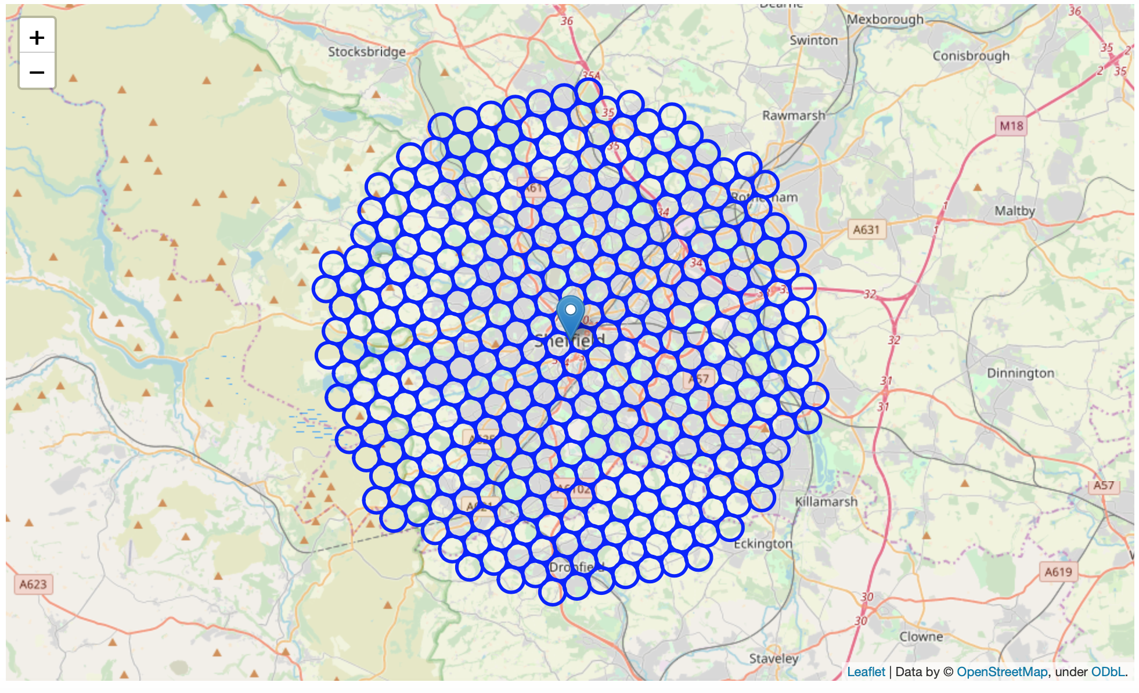
Methodology – Grid of regions

Slide 7
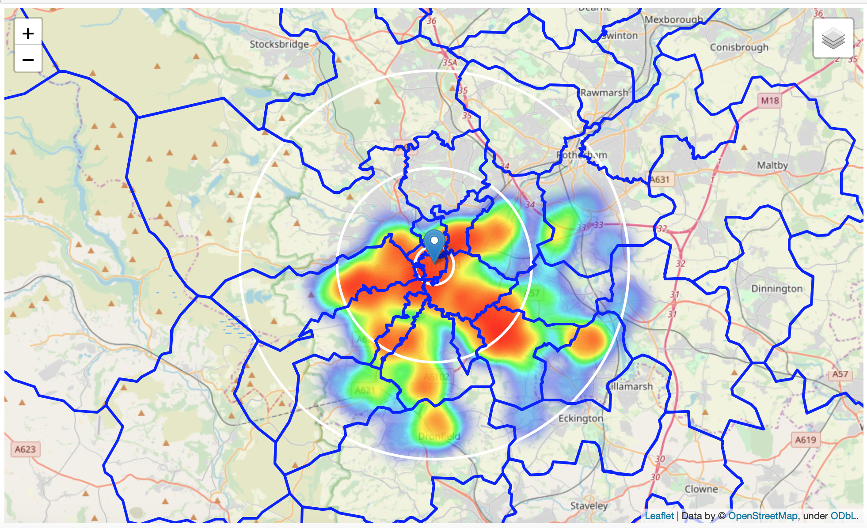
Methodology – Heatmap

Slide 8
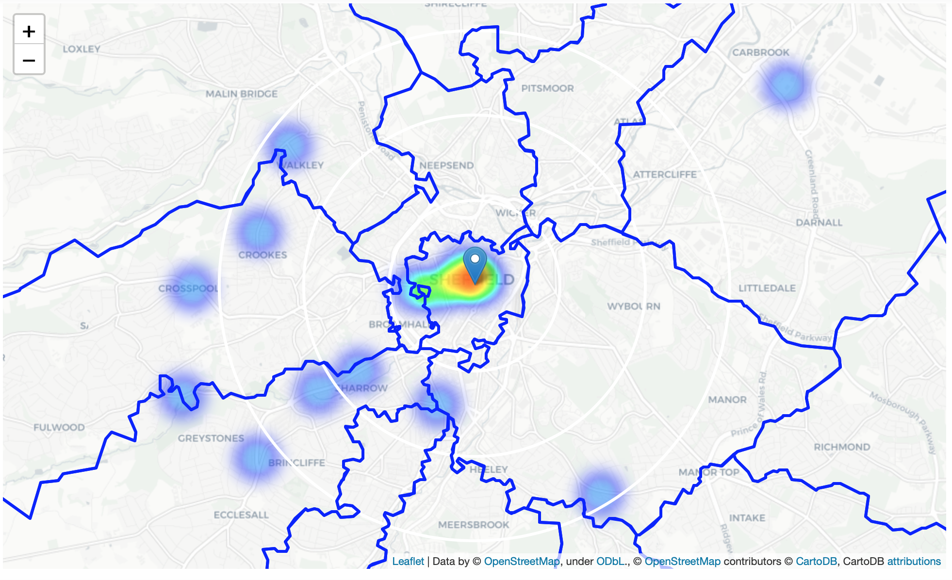
Methodology – Heatmap (Italian Only)

Slide 9
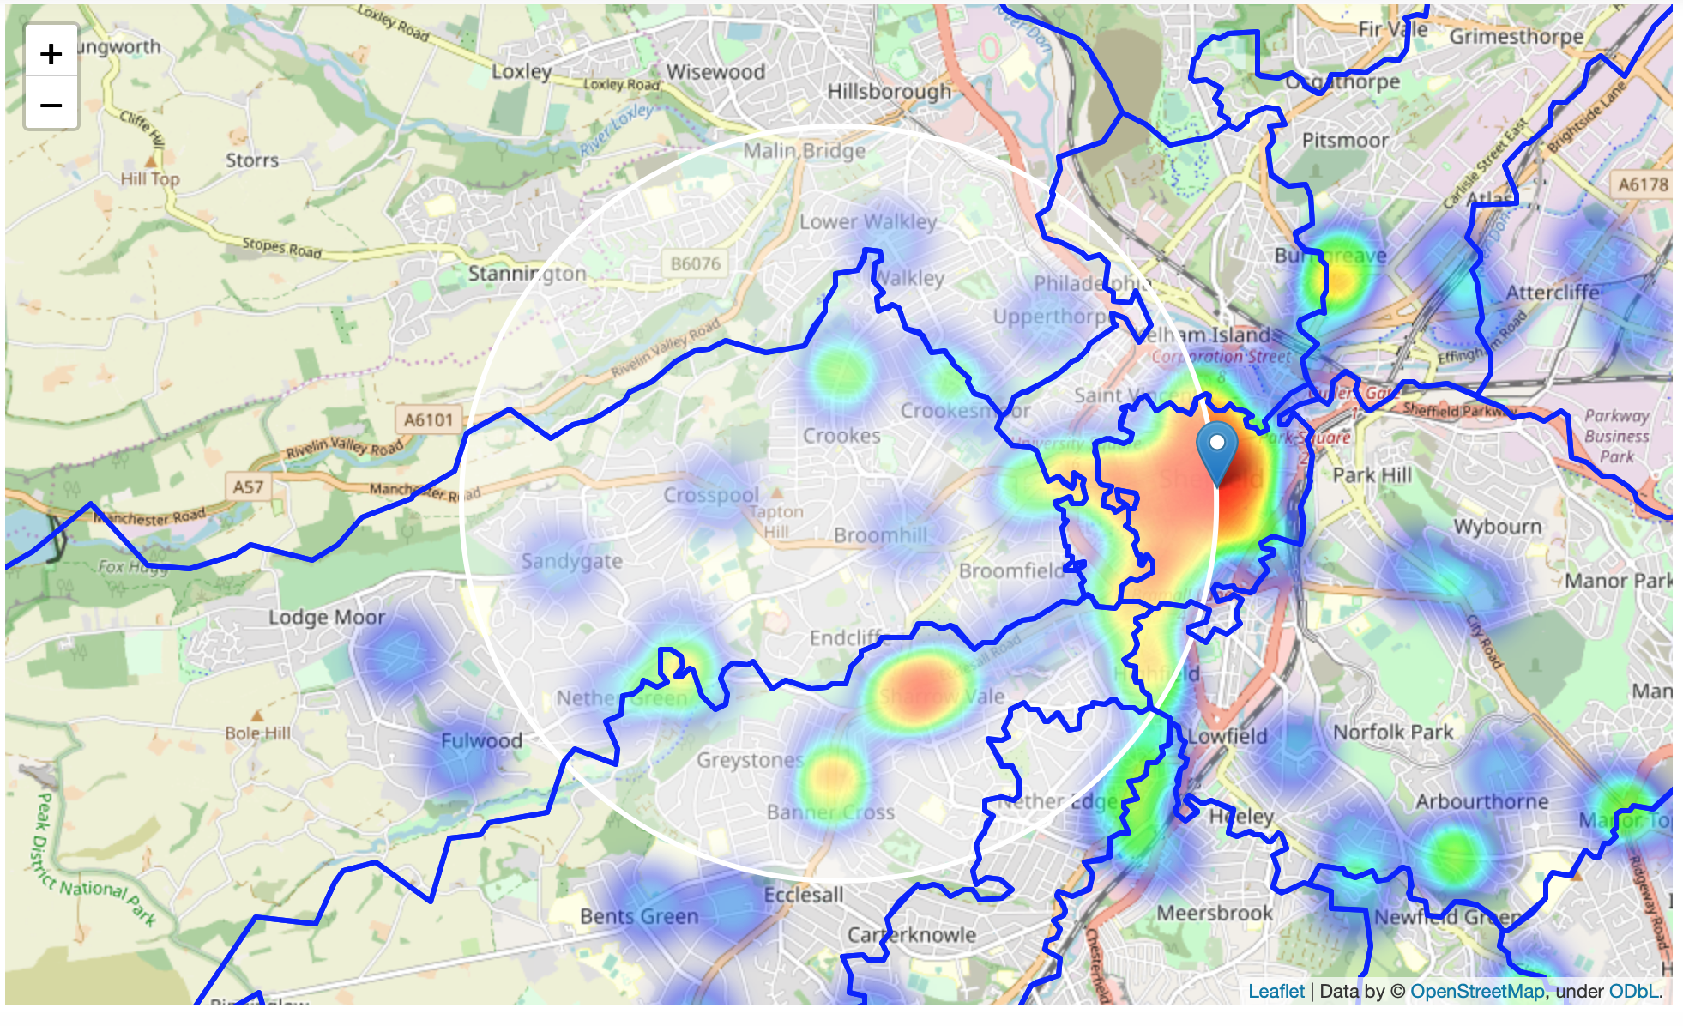
Methodology – Heatmap (centered on High Student Area)

Slide 10
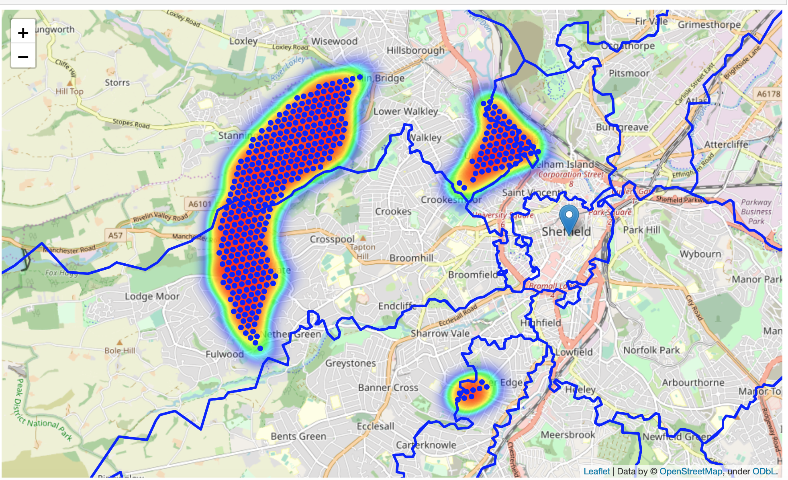
Methodology – Mapping Possible Locations

Slide 11
Results
15 top locations were identified
31 Woodfarm Dr, Sheffield S6 5LW, UK => 4.3km from Peace Gardens
2 Cross Bedford St, Sheffield S6 3AT, UK => 1.5km from Peace Gardens
23 Burnt Stones Cl, Sheffield S10 5TS, UK => 4.7km from Peace Gardens
2 Raven Rd, Nether Edge, Sheffield S7 1SB, UK => 2.6km from Peace Gardens
Wood Lane, Sheffield S6 5AZ, UK => 4.0km from Peace Gardens
80 Hall Park Hill, Sheffield S6 5QU, UK => 4.6km from Peace Gardens
801 Manchester Rd, Sheffield S10 5SY, UK => 4.7km from Peace Gardens
34 Addy St, Sheffield S6 3FU, UK => 1.6km from Peace Gardens
66 Stumperlowe Cres Rd, Sheffield S10 3PR, UK => 4.8km from Peace Gardens
Rivelin View, Roscoe Bank, Sheffield S6 5SB, UK => 4.6km from Peace Gardens
46 Rivelin Park Dr, Sheffield S6 5GG, UK => 3.8km from Peace Gardens
10 Balaclava Rd, Sheffield S6 3BG, UK => 1.9km from Peace Gardens
72 Carsick Hill Rd, Sheffield S10 3LX, UK => 4.6km from Peace Gardens
89 Roscoe Bank, Sheffield S6, UK => 4.0km from Peace Gardens

Slide 12
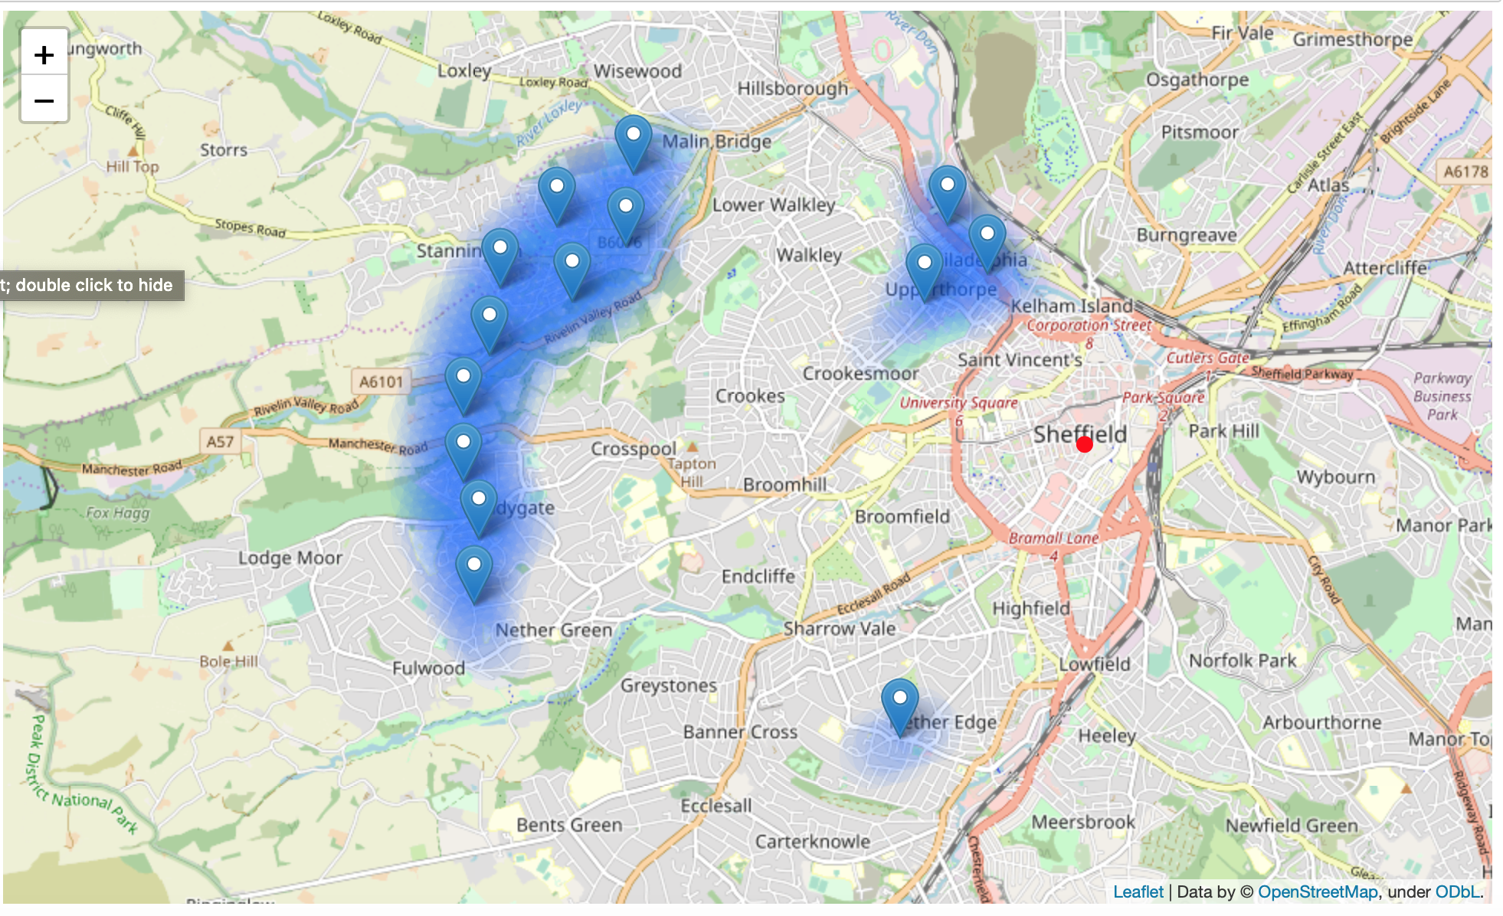
Locations for Possible Restaurants

Slide 13
Discussion
Sheffield is not Berlin
Lower density of people and restaurants meant search parameters had to be adjusted
Sheffield restaurant use is more likely to be from students than tourists
Without mapping population density some of the suggested locations would have been in national parkland
Choosing areas based on student locations helped reduce this error
There is always a chance that the reason there is no Italian restaurant in a given area is because the local behaviour is to head for the city centre

Slide 14
Conclusion
Suitable locations were identified
Further research should be done to see if these locations merit a restaurant
Surveying local inhabitants would be wise
The tools need to be adjusted when changing city
What works well for one city will not work as well for another

